Slide 1




GridWorld
© A+ Computer Science - www.apluscompsci.com

Slide 2
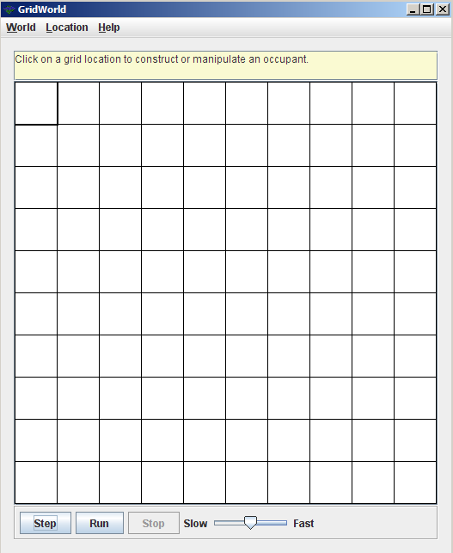
What is GridWorld?
Row = 0
Column = 0
© A+ Computer Science - www.apluscompsci.com
Notes:
A grid is a structure that has rows and columns.
A spreadsheet is a grid.
A checker board is a grid.

Slide 3
What is GridWorld?
cols
rows
A grid is a structure that has rows and columns.
© A+ Computer Science - www.apluscompsci.com
Notes:
A grid is a structure that has rows and columns.
A spreadsheet is a grid.
A checker board is a grid.

Slide 4
What is GridWorld?
Row = 2
Column = 1
© A+ Computer Science - www.apluscompsci.com
Notes:
A grid is a structure that has rows and columns.
A spreadsheet is a grid.
A checker board is a grid.

Slide 5
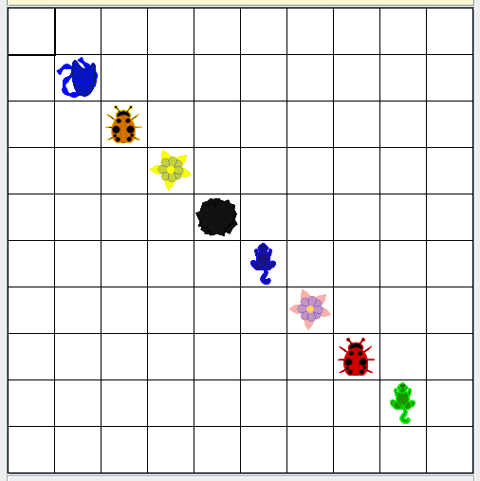
What is GridWorld?
© A+ Computer Science - www.apluscompsci.com

Slide 6
Grid
© A+ Computer Science - www.apluscompsci.com

Slide 7
Grid
Grid is an interface that details the
behaviors expected of a Grid.
Grid was designed as an interface because many different structures could be used to store the grid values.
An interface works perfectly due to the
large number of unknowns.
© A+ Computer Science - www.apluscompsci.com
Notes:
Grid is a row / column structure that stores Objects.
The location of each Object is determined by the Location provided when putting the Object in the grid.

Slide 8
Grid abstract methods
Name | Use
get(loc) | returns the ref at location loc
getEmptyAdjacentLocations(loc) | gets the valid empty locs in 8 dirs
getNeighbors(loc) | returns the objs around this in 8 dirs
getNumCols() | gets the # of cols for this grid
getNumRows() | gets the # of rows for this grid
getOccupiedAdjacentLocations(loc) | gets the valid locs in 8 dirs that contain objs
getOccupiedLocations() | gets locs that contain live objs
getValidAdjacentLocations(loc) | gets the valid locs in 8 dirs
isValid(loc) | checks to see if loc is valid
put(loc, obj) | put the obj in grid at location loc
remove(loc) | take the obj at location loc out of the grid
import info.gridworld.grid.Grid;
© A+ Computer Science - www.apluscompsci.com

Slide 9
Grid
rows
0 | 0 | 0 | 0 | 0
0 | 0 | 0 | 0 | 0
0 | 0 | 0 | 0 | 0
0 | 0 | 0 | 0 | 0
0 | 0 | 0 | 0 | 0
rows
A grid is a structure that has rows and columns.
© A+ Computer Science - www.apluscompsci.com
Notes:
A grid is a structure that has rows and columns.
A spreadsheet is a grid.
A checker board is a grid.

Slide 10
Grid
cols
cols
0 | 0 | 0 | 0 | 0
0 | 0 | 0 | 0 | 0
0 | 0 | 0 | 0 | 0
0 | 0 | 0 | 0 | 0
0 | 0 | 0 | 0 | 0
A grid is a structure that has rows and columns.
© A+ Computer Science - www.apluscompsci.com
Notes:
A grid is a structure that has rows and columns.
A spreadsheet is a grid.
A checker board is a grid.

Slide 11
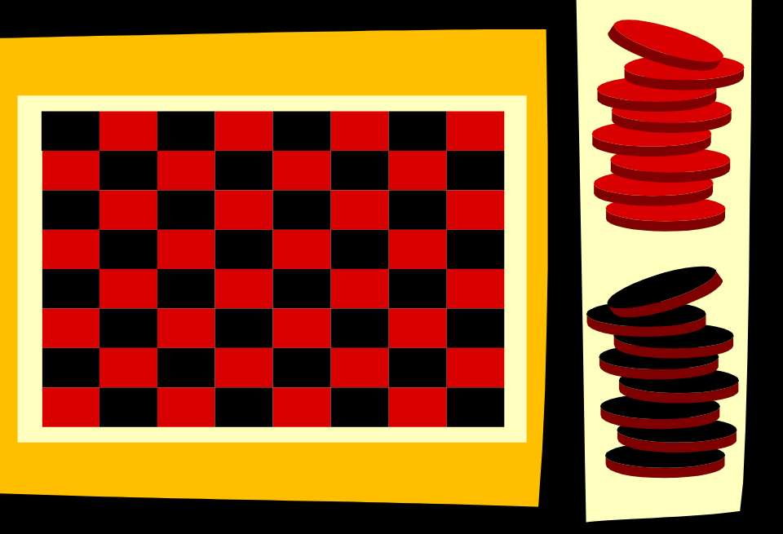
Grid
A grid is a structure that has rows and columns.
© A+ Computer Science - www.apluscompsci.com
Notes:
A grid is a structure that has rows and columns.
A spreadsheet is a grid.
A checker board is a grid.

Slide 12
Critter
© A+ Computer Science - www.apluscompsci.com

Slide 13
Critter extends Actor frequently used methods
Name | Use
getColor() | gets the critter's color
getDirection() | gets the critter's direction
getLocation() | gets the critter's location
setColor(col) | sets the critter's color to col
setDirection(dir) | sets the critter's direction to dir
import info.gridworld.actor.Critter;
© A+ Computer Science - www.apluscompsci.com
Notes:
The methods listed below were inherited from actor.
The act method has been overridden as the behavior of a bug is quite different from an actor.
The other methods listed above that were inherited have not been changed.

Slide 14
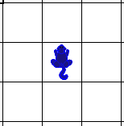
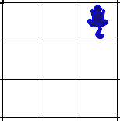
Critter
Critter differs from actor in that a critter moves around the grid and eats specific types of other actors.
Critter randomly picks one of its valid adjacent empty locations and moves to that location.
© A+ Computer Science - www.apluscompsci.com
Notes:
Critter is a suped up actor that moves around the grid and eats other actors.
Critter selects any of its neighbors that are empty and valid. Critter moves to the new location.

Slide 15
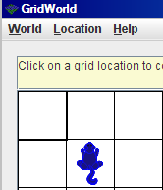
Critter
ActorWorld world = new ActorWorld();
Critter thang = new Critter();
world.add(new Location(1,1), thang);
world.show();
© A+ Computer Science - www.apluscompsci.com

Slide 16
open
critterone.java
© A+ Computer Science - www.apluscompsci.com

Slide 17
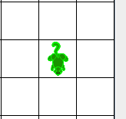
Critter
ActorWorld world = new ActorWorld();
Critter thang = new Critter();
thang.setColor(Color.GREEN);
thang.setDirection(180);
Location loc = new Location(2,2);
world.add(loc, thang);
world.show();
© A+ Computer Science - www.apluscompsci.com

Slide 18
open
crittertwo.java
© A+ Computer Science - www.apluscompsci.com

Slide 19
Critter extends Actor frequently used methods – Critter specific
Name | Use
act() | calls the methods listed below
getActors() | gets all actors around this location
processActors(actors) | do something to actors sent in
getMoveLocations() | gets list of possible move locs
selectMoveLocation(locs) | picks loc to move to
makeMove(loc) | moves this critter to loc
import info.gridworld.actor.Critter;
© A+ Computer Science - www.apluscompsci.com
Notes:
Critter’s act method first calls the getActors method to get a list of actors around this critter.
Act then calls processActors and sends it the ArrayList of actors built by getActors. processActors typically does something to some or all of the actors in the list.
Act calls getMoveLocations next. getMoveLocations builds and returns an ArrayList of locations to which this critter could move.
selectMoveLocation is called and sent the ArrayList built by getMoveLocations. selectMoveLocation randomly picks one of the locations and returns it.
makeMove is called last by act and makes the critter move if possible.

Slide 20
act
if no grid present – stop
call getActors to get list of actors to proces processActors received from getActors
call getMoveLocations to get a list of locations
to which the critter might move
call selectMoveLocation to select new location
move to the new loc
© A+ Computer Science - www.apluscompsci.com
Notes:
Critter’s act method first calls the getActors method to get a list of actors around this critter.
Act then calls processActors and sends it the ArrayList of actors built by getActors. processActors typically does something to some or all of the actors in the list.
Act calls getMoveLocations next. getMoveLocations builds and returns an ArrayList of locations to which this critter could move.
selectMoveLocation is called and sent the ArrayList built by getMoveLocations. selectMoveLocation randomly picks one of the locations and returns it.
makeMove is called last by act and makes the critter move if possible.

Slide 21
getActors
The getActors method returns an ArrayList containing all of the actors around this critter using the 4 cardinal(N,S,E,W) and 4 intercardinal directions(NE, NW, SE, SW).
In order to change which actors are returned by getActors, override the method and provide a different method of selecting actors.
getActors must not modify any actors.
© A+ Computer Science - www.apluscompsci.com
Notes:
Critter’s act method first calls the getActors method to get a list of actors around this critter.
Act then calls processActors and sends it the ArrayList of actors built by getActors. processActors typically does something to some or all of the actors.

Slide 22
Extending
Critter
© A+ Computer Science - www.apluscompsci.com

Slide 23
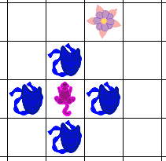
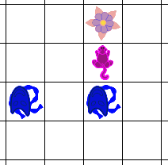
Extending Critter
Use the GW quick reference!
What has to change if you want a critter to only get actors
in front and behind?
© A+ Computer Science - www.apluscompsci.com

Slide 24
Extending Critter
public class GetInFrontBehindCritter extends Critter
{
//constructor
public ArrayList<Actor> getActors()
{
}
}
What code is needed?
© A+ Computer Science - www.apluscompsci.com
Notes:
The original critter will select all adjacent actors.

Slide 25
open
getinfrontbehindcritter.java
getinfrontbehindcritterrunner.java
© A+ Computer Science - www.apluscompsci.com

Slide 26
processActors
The processActors method will do something to some or all of the actors around this critter.
The processActors receives a list of all actors around this actor based on this actor’s getActors method.
The critter act method calls getActors and passes the returned ArrayList to processActors.
processActors must only change the actors received in the ArrayList parameter.
© A+ Computer Science - www.apluscompsci.com
Notes:
Critter’s act method first calls the getActors method to get a list of actors around this critter.
Act then calls processActors and sends it the ArrayList of actors built by getActors. processActors typically does something to some or all of the actors.

Slide 27
Extending
Critter
© A+ Computer Science - www.apluscompsci.com

Slide 28
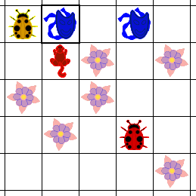
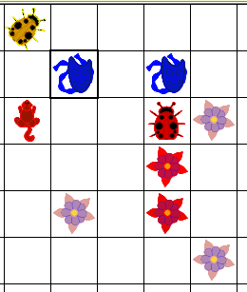
Extending Critter
Use the GW quick reference!
What has to change if you want a critter to only eat flowers?
© A+ Computer Science - www.apluscompsci.com
Notes:
The original critter eats everything except rocks and other critters.
Which method is used to manipulate the other actors around this critter? processActors
How much of processActors has to change so that the critter eats only rocks?

Slide 29
Extending Critter
public class FlowerEatingCritter extends Critter
{
//constructor
public void processActors(ArrayList<Actor> actors)
{
}
}
What code is needed?
© A+ Computer Science - www.apluscompsci.com
Notes:
The original critter eats everything except rocks and other critters.
Which method is used to manipulate the other actors around this critter? processActors
How much of processActors has to change so that the critter eats only rocks?

Slide 30
open
flowereatingcritter.java
flowereatingcritterrunner.java
© A+ Computer Science - www.apluscompsci.com

Slide 31
getMoveLocations
The getMoveLocations method returns a list of all empty adjacent locations to which this critter could move.
In order to change which locations are returned by getMoveLocations, override the method and provide a different method of selecting move locations.
getMoveLocations must not modify any actors.
© A+ Computer Science - www.apluscompsci.com
Notes:
Act calls getMoveLocations next. getMoveLocations builds and returns an ArrayList of locations to which this critter could move.
selectMoveLocation is called and sent the ArrayList built by getMoveLocations. selectMoveLocation randomly picks one of the locations and returns it.

Slide 32
selectMoveLocation
The selectMoveLocation method selects a possible move location from the list of locations returned by getMoveLocations.
The selectMoveLocation receives a list of all actors around this actor based on this actor’s getMoveLocations method.
The critter act method calls getMoveLocations and passes the returned ArrayList to selectMoveLocation.
selectMoveLocation must not modify any actors.
© A+ Computer Science - www.apluscompsci.com
Notes:
Act calls getMoveLocations next. getMoveLocations builds and returns an ArrayList of locations to which this critter could move.
selectMoveLocation is called and sent the ArrayList built by getMoveLocations. selectMoveLocation randomly picks one of the locations and returns it.

Slide 33
makeMove
The makeMove method receives a location
parameter.
If the parameter is null, the critter is removed from the grid.
If the parameter is not null, the critter moves to the new location. If an actor was in the location the critter is moving to, the actor is removed.
makeMove must only modify the actors at this critter’s new and old locations.
© A+ Computer Science - www.apluscompsci.com
Notes:
.
makeMove is called last by act and makes the critter move if possible.

Slide 34
open
crabcritter.java
chameleoncritter.java
© A+ Computer Science - www.apluscompsci.com

Slide 35
Start work
on Critter Labs
and Exercises
© A+ Computer Science - www.apluscompsci.com

